Slide 1
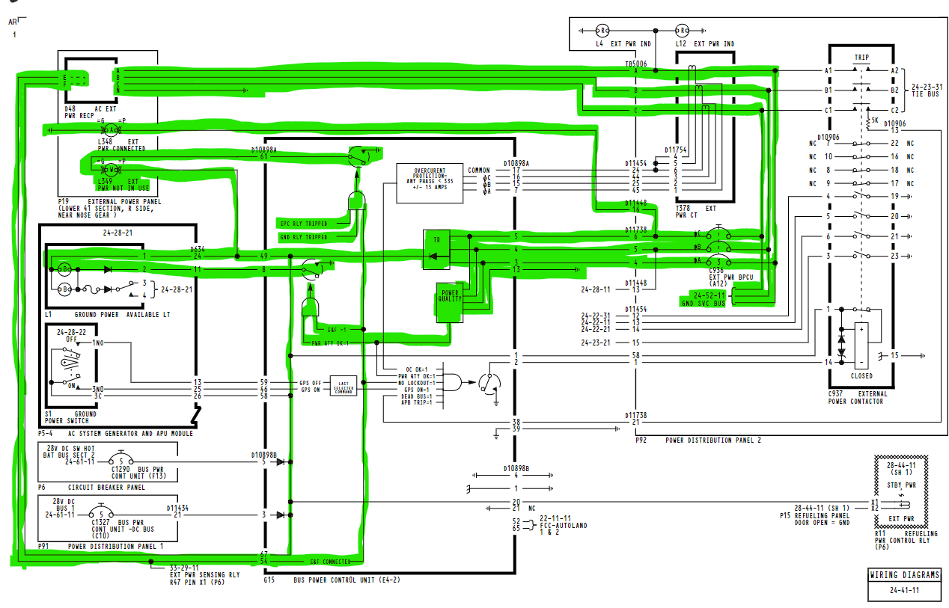
How to power the ground service buses only
(No battery switch input is required)
AMM SUBTASK 24-22-00-860-004
SSM 24-41-11

Slide 2
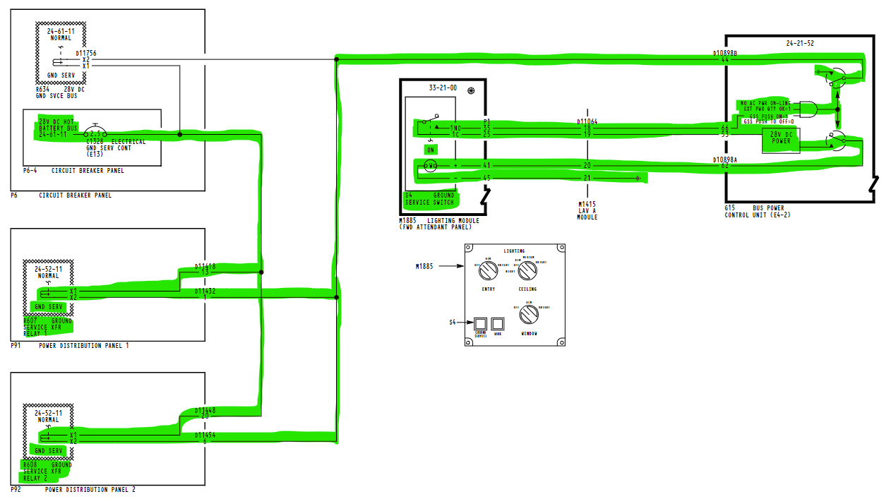
How to power the ground service buses only
(No battery switch input is required)
AMM SUBTASK 24-22-00-860-004
HOT BAT BUS!
SSM 24-23-51

Slide 3
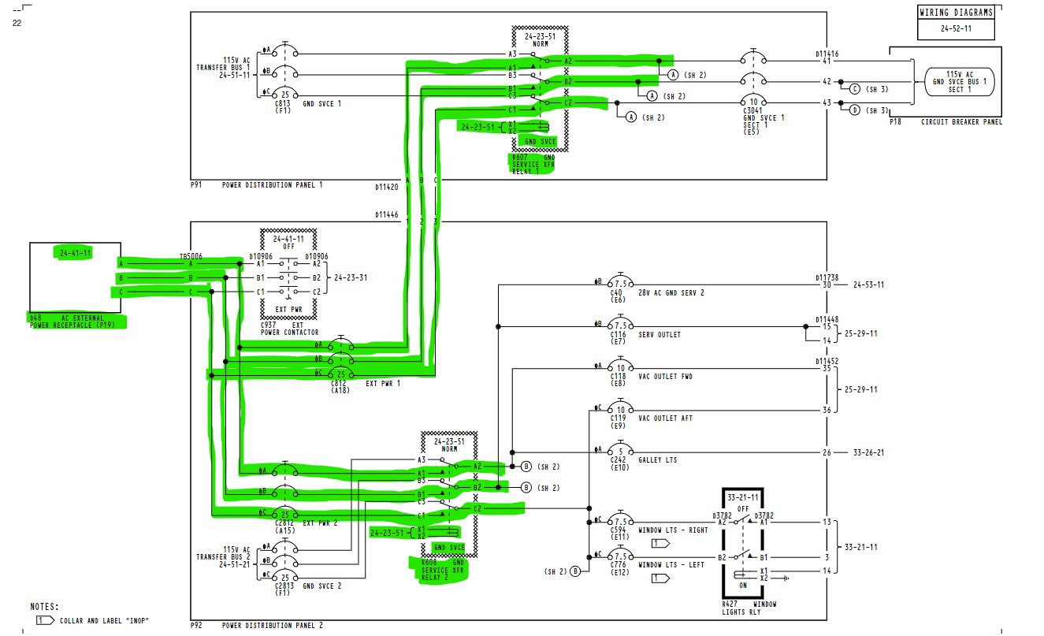
How to power the ground service buses only
(No battery switch input is required)
AMM SUBTASK 24-22-00-860-004
SSM 24-52-11

Slide 4
How to power the ground service buses only
(No battery switch input is required)
AMM SUBTASK 24-22-00-860-004
L349 is off
SSM 24-41-11

